Slide 1
Potpourri (IP stuff)
CS 168 – Fall 2017 – Section 5

Slide 2
Agenda
Poison Reverse and Split Horizons FAQs
Reliable Transport (short and sweet)
Goals of reliable transport
Windowing
IP Packet
Header Fields
Fragmentation
Application
Transport
Network
Datalink
Physical

Slide 3
Poison Reverse and Split Horizon FAQs!

Slide 4
Quick Refresher
When to use these mechanisms? (Clue: same reason)
Neighbor advertises route x to destination y that goes through that same neighbor
Split Horizon
I didn’t lie. I just didn’t tell the whole truth.
Mechanism: Don’t tell the neighbor distance to destination y
Poison Reverse
I straight up lie.
Mechanism: Tell the neighbor I am a distance infinity away from destination y

Slide 5
Split Horizon and Poison Reverse are proactive!
Both poison reverse and split horizon attempt to prevent forwarding loops that might happen in the future
Hypothetically, if the routing state remains unchanged, doing split horizon or poison reverse is entirely redundant!!

Slide 6
Split Horizon and Poison Reverse are proactive!
Both poison reverse and split horizon attempt to prevent forwarding loops that might happen in the future
Hypothetically, if the routing state remains unchanged, doing split horizon or poison reverse is entirely redundant!!
Poison reverse and split horizon anticipate failures and proactively prevent forwarding loops when those failures arrive

Slide 7
Split Horizon vs. Poison Reverse
Poison Reverse: Paranoid Proactive
Split Horizon: Passively Proactive
Tradeoff
Speed of Protecting against forwarding loops
Poison Reverse immediately, aggressively, and explicitly removes potential forwarding loops before they can appear/propagate
Bandwidth:
Poison Reverse updates can be large
Node 1
Node 2
Node 3
Node 5000
…......
Poison routes to Nodes 3-5000 ☹

Slide 8
Reliable Transport

Slide 9
Goals of Reliable Transport
Correctness
IFF
All dropped or corrupted packets are resent
Progress is attempted
Timeliness
Minimize time of data transfer
Efficiency
Minimize Usage of bandwidth
Fairness
How well does it play with other flows?

Slide 10
Reliable Transport over multiple packets
Timeliness Goal (with correctness constraint in mind)
How do we have multiple packets in flight at the same time?
Windowing!
Animation: https://www.youtube.com/watch?v=zY3Sxvj8kZA

Slide 11
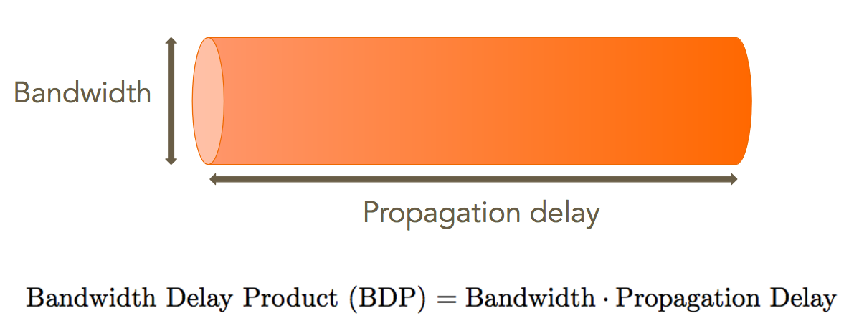
Choosing Window Size
Intuition: When I finish sending the last packet in my window, I should be getting back an ACK from the first packet in my window
How do determine the window size?
Hint: (RTT * Bandwidth) = ?

Slide 12
Choosing Window Size
Intuition: When I finish sending the last packet in my window, I should be getting back an ACK from the first packet in my window
How do determine the window size?
Hint: (RTT * Bandwidth) = 2 * (Bandwidth Delay Product)
2 * BDP = (Window size) * (Packet Size)

Slide 13
IP Packet

Slide 14
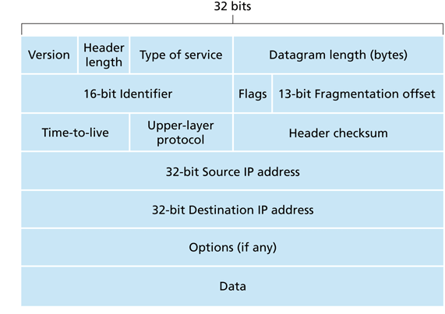
IP Packet Header Fields
20 Byte Header (without Options)
Version (4b): 4 for IPv4 and 6 for IPv6
Header Length (4b): typically set to 5 words (20 bytes) without IP Options.
Type of Service (8b): allow packets to be treated differently
Datagram Length (16b): number of bytes in the packet (maximum 2^16-1)

Slide 15
IP Packet Header Fields
20 Byte Header (without Options)
Identifier (16b): used for uniquely identifying the group of fragments of a single IP datagram
Flags (3b): R (Reserved, must be 0)/DF (Don’t Fragment)/MF (More Fragments).
Fragmentation Offset (13b): offset from original payload (8-byte units) this fragment contains. Used for reassembling packets into datagram

Slide 16
IP Packet Header Fields
20 Byte Header (without Options)
Time-To-Live (8b): used to avoid loops (decrement TTL of the packet by 1 at each hop, discard packet if TTL reaches 0)
Upper-Layer-Protocol (8b): next higher level protocol to use (6 for TCP, 17 for UDP)
Header Checksum (16b): checksum over entire header (recomputed at each hop)

Slide 17
IP Packet Header Fields
20 Byte Header (without Options)
Source IP Address (32b): IP address where the packet is sent from
Destination IP Address (32b): IP address where the packet is sent to

Slide 18
IP Packet Header Example
Version
4
Header
Length
5
Type of Service
0
Datagram Length: 1220
Identifier: 56273
Flags
0/0/1
Fragmentataion Offset: 185
Time-To-Live
127
Protocol
6
Header Checksum: xxx
Source IP Address: 1.2.3.4
Destination IP Address: 3.4.5.6

Slide 19
IP Header Design Remarks
Header corrupted:
Show the header is corrupted or not: Checksum
Recomputed at each hop because of changed TTL

Slide 20
IP Header Design Remarks
Potential loops:
Use one field to track how long the packet has traveled: TTL
Decrement TTL by 1 at each hop; discard packet if TTL reaches 0

Slide 21
IP Header Design Remarks
Packet too large:
Use fragmentation and reassemble packets at the end host: Total Length, Identification, Flags (MF), Fragment Offset
Check Total Length to see if the router can process the packet
If not, fragment the packet into small packets with same ID
Set MF to 1 for all sub packets except the last one with MF 0.
Assign Fragment Offset to all sub packets

Slide 22
Fragmentation Design Remark
Why bother fragmenting the packet?
Links have their own capacity
Maximum Transmission Unit (MTU): largest number of bits it can carry as one unit (in one packet)
Why reassemble the packets at end host, but not at each router?
Classic case of E2E Principle
Impose burden on network (complicated reassembly algorithms)
Fragments might take different paths
Packets might get fragmented recursively!

Slide 23
Fragmentation Example
MTU = 500 bytes
20 Byte Header
580 bytes
Total length = 600 bytes
Flags = 000
Offset = 0
20 Byte Header
20 Byte Header
480 bytes
100 bytes
Total length = 500 bytes
Flags = 001
Offset = 0
Total length = 120 bytes
Flags = 000
Offset = 480/8 = 60

